Slide 1
Secure Vault
Information System Security Project

Slide 2
Table of Contents
Overview
Understanding the problems
Project Objective
Features
Further Improvements
Conclusion

Slide 3
Overview
Created an user interactive web app for storing user sensitive information by hashing password and encrypting the information. Used JSX, CSS, javascript, React.js, realtime database from firebase for frontend, backend of the webapp and deployed the application in vercel. passwords are hashed on the client side before storing in database and this hash key is used for the authentication of user. Provided the features for storing user information directly after encryption and the decrypted information is displayed only after validating the key entered by the user with the stored hash key.

Slide 4
Understanding the problems
Generally It’s hard to remember & recall different strong secure passwords for different websites.
Card details are generally saved as plain-text in cloud by users so that they can use it in across devices and it's generally targeted by hackers.
There is lack of proper encrypted storage applications for saving sensitive personal information.

Slide 5
Project objective
Storing the Sensitive Information like passwords, card details securely and can be easily able to access only by the authenticated user.
The user information is stored in encrypted format using AES cipher, SHA-256 Hashing . The encryption and hashing are done at client’s side.

Slide 6
Features
User passwords are not saved in the database only the SHA-256 hash value is saved for comparison and hashing is performed on client side.
Add passwords, add card details, ,add text data features are included in this web app where user can store the website and the account username and password information, Credit/Debit card details, directly storing the text respectively
This data is saved after performing AES encryption at the client side, is saved in the firebase realtime database.
Used FireBase auth rules for database so that no users can access data handling APIs without authentication.
User data is decrypted and displayed after validating the user by prompting for key.

Slide 7
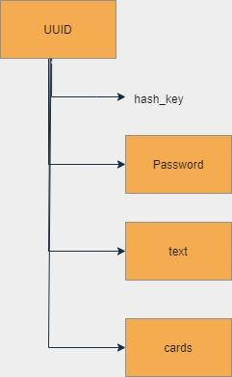
Fire Store Realtime Database
Easily get data in Real-Time, Effortlessly Scalable.
Firestore can be used either on the client or server.
Flexibility as a NoSQL Database.
NoSQL means that the data isn't stored in tables and columns as a standard SQL database would be. It is structured like a key-value store, as if it was one big JavaScript object.
Only authenticated users can access collection with name as UUID
Database Schema

Slide 8
SHA-256 Hashing
Hashing is primarily used for authentication.
Secure Hashing Algorithm is a One way cryptographic function which cannot be decrypted back, data is mapped to a fixed-length value.
SHA-256 generates a 256-bit (32-byte) unique signature of a text.
Best Known Hashing algorithm used in most SSL(secure sockets layer)/TLS cipher suites.

Slide 9
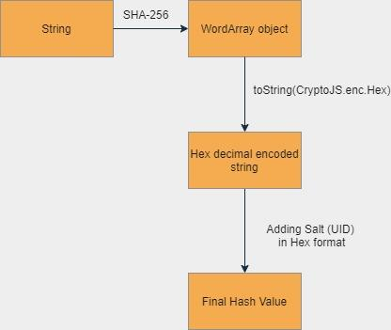
SHA-256 Hashing

Slide 10
AES Cipher
Advanced Encryption Standard is a commonly used algorithm with SSL/TLS.
CryptoJS.AES.encrypt returns an object that contains the decryption keys. The .toString() method of this library specifically ensures that the output is safe to be stored and cannot be decrypted. Storing the resulting object or encoding it isn't safe as it'd contain the decryption key.
It puts plaintext through a number of “transformation rounds” determined by key size, each round consists of several processing steps.
A symmetric block cipher

Slide 11
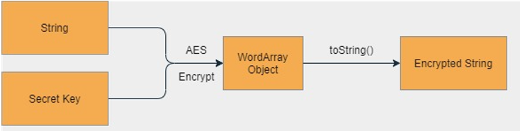
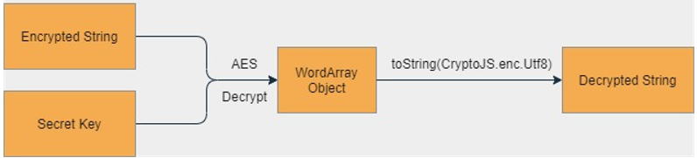
AES Cipher
Encryption
Decryption

Slide 12
Further Improvements
Automatic Strong Password Generator.
Individual Secret key for cards, text and passwords respectively.
Update keys, Forgot password, Login authentication directly with google accounts, github etc.
Saving Large Files.
Implementing browser extension for saving passwords and usernames entered in the website directly into the app.

Slide 13
Thank you!

